Slide 1
Cryptography (2022 Fall) fixed-length encryption from PRG, one-way function, hard-core predicate, PRG construction, stream cipher, IND-m-EAV
LiangFeng Zhang
zhanglf@shanghaitech.edu.cn
SIST, ShanghaiTech

Slide 2
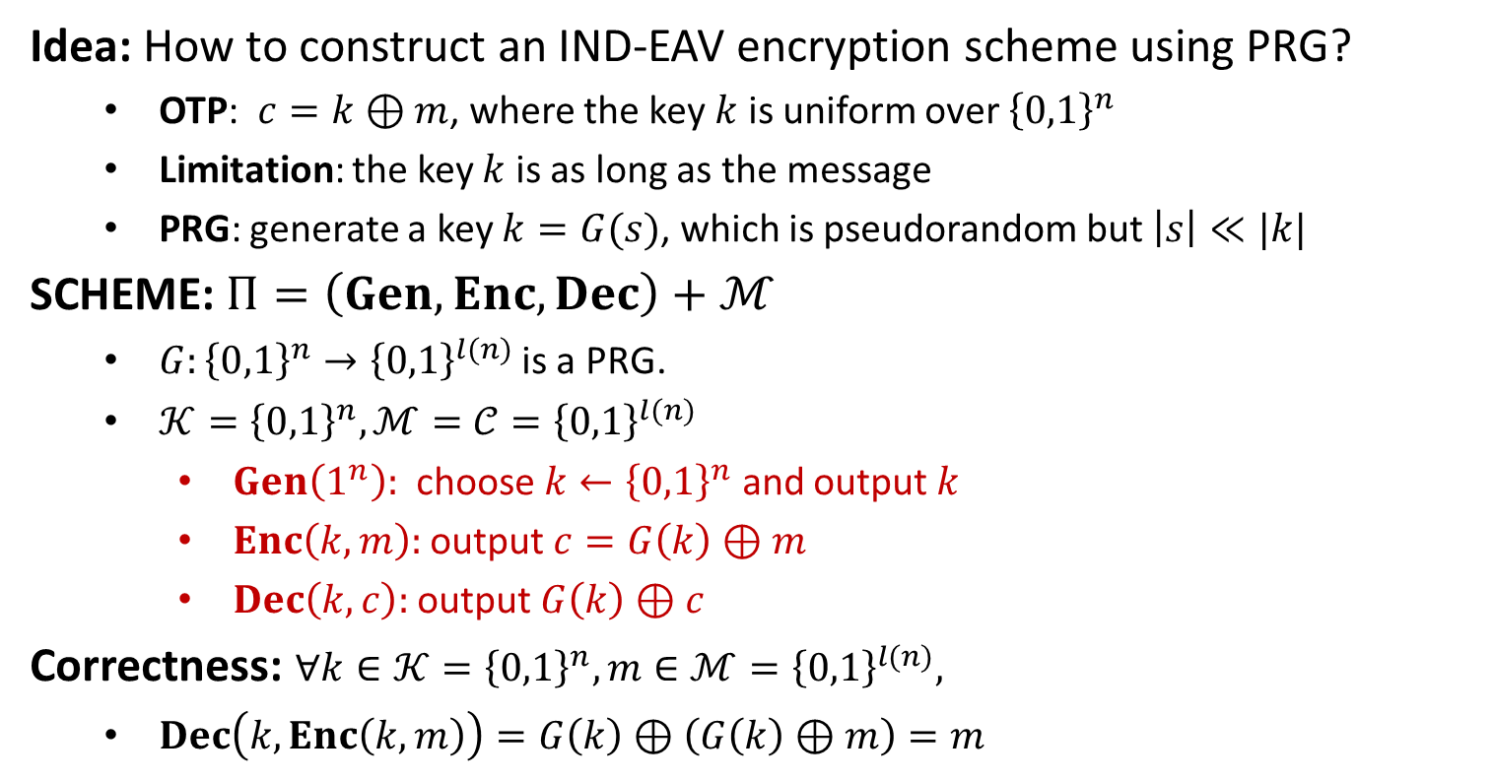
Fixed-Length Encryption from PRG
Idea: How to construct an IND-EAV encryption scheme using PRG?
OTP: $c=k⊕m$, where the key $k$ is uniform over ${\left\{0,1\right\}}^{n}$
Limitation: the key $k$ is as long as the message
PRG: generate a key $k=G(s)$, which is pseudorandom but $\left|s\right|≪|k|$
SCHEME: $Π=\left(Gen, Enc, Dec\right)+ℳ$
$G:{\left\{0,1\right\}}^{n}→{\left\{0,1\right\}}^{l(n)}$is a PRG.
$𝒦={\left\{0,1\right\}}^{n}, ℳ=𝒞={\left\{0,1\right\}}^{l(n)}$
$Gen\left(1^{n}\right):$ choose $k←{\left\{0,1\right\}}^{n}$ and output $k$
$Enc\left(k,m\right):$ output $c=G\left(k\right)⊕m$
$Dec\left(k,c\right):$ output $G\left(k\right)⊕c$
Correctness: $∀k∈𝒦={\left\{0,1\right\}}^{n}, m∈ℳ={\left\{0,1\right\}}^{l(n)},$
$Dec\left(k,Enc\left(k,m\right)\right)=G\left(k\right)⊕\left(G\left(k\right)⊕m\right)=m$

Slide 3
Fixed-Length Encryption from PRG
THEOREM: If $G$ is a PRG, then the scheme $Π$ is IND-EAV secure.
Suppose that $Π$ is not IND-EAV secure. Then $∃$ PPT adversary $𝒜$ such that
$$ε=\left|\operatorname{Pr}\left[PrivK_{𝒜, Π}^{eav}\left(n\right)=1\right] −1/2\right|$$
is non-negligible in $n$.
Without loss of generality, suppose that
$ε=\operatorname{Pr}\left[PrivK_{𝒜, Π}^{eav}\left(n\right)=1\right] −1/2$
We construct a PPT distinguisher $𝒟$ that distinguishes between $G(U_{n})$ and $U_{l(n)}$ with non-negligible probability. (gives a contradiction)
INPUT: $x∈{\left\{0,1\right\}}^{l\left(n\right)}, x←G(U_{n})$ or $x←U_{l(n)}$
$𝒟$ uses $x$ as the pad in the adversarial indistinguishability experiment
If $𝒜$’s guess $b^{′}=b$, output 1
otherwise, output 0.

Slide 4

Distinguisher $𝒟$
$$x$$
choose $m_{0}, m_{1}∈{\left\{0,1\right\}}^{l(n)}$
$$m_{0},m_{1}$$
$$b←\{0,1\}$$
$$c=x⊕m_{b}$$
$$c$$
$$b^{′}$$
$$b^{′′}=\left\{\begin{aligned}0 b^{′}≠b \\ 1 b^{′}=b\end{aligned}\right.$$
$$b′′$$
PRG Challenger
$$𝒟$$
$$𝒜$$
Experiment PRG
Experiment $E$

Slide 5
Distinguisher $𝒟$
$x←G\left(U_{n}\right):$ the experiment $E$ is $PrivK_{𝒜, Π}^{eav}\left(n\right)$
$\operatorname{Pr}\left[𝒟\left(x\right)=1\right]=\operatorname{Pr}\left[PrivK_{𝒜, Π}^{eav}\left(n\right)=1\right]=\frac{1}{2}+ε$
$x←U_{l\left(n\right)}:$ the experiment $E$ is $PrivK_{𝒜, OTP}^{eav}\left(l(n)\right)$
$\operatorname{Pr}\left[𝒟\left(x\right)=1\right]=\operatorname{Pr}\left[PrivK_{𝒜, OTP}^{eav}\left(l(n)\right)=1\right]=\frac{1}{2}$
$\left|\operatorname{Pr}\left[𝒟\left(G\left(U_{n}\right)\right)=1\right]−\operatorname{Pr}\left[𝒟\left(U_{l\left(n\right)}\right)=1\right]\right|=ε$, which is non-negligible
$G$ cannot be a PRG, contradiction.
REMARKs: Comparisons with One-Time Pad (Efficiency and Security)
Shorter secret key: encrypt $l(n)$-bit message using $n$ truly random bits
EXAMPLE: $n=128, l\left(n\right)={10}^{6}$
This is much better that OTP.
The secret key cannot be reused.
Security: IND-EAV, weaker than perfectly secret.

Slide 7



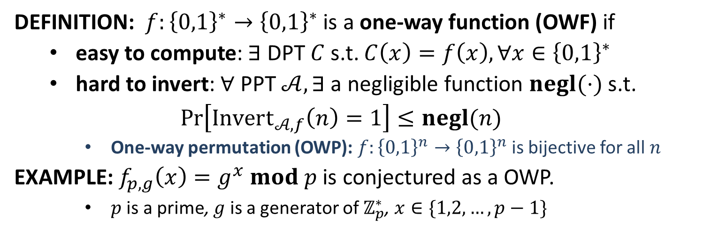




One-Way Function
The Inverting Experiment $Invert_{𝒜,f}\left(n\right)$ for $f:{\left\{0,1\right\}}^{∗}→{\left\{0,1\right\}}^{∗}$
$$x←{\left\{0,1\right\}}^{n}$$
$$y=f(x)$$
$$y$$
$$x′$$
$$Challenger$$
$$Invert_{𝒜,f}\left(n\right)=$$
$\left\{\begin{aligned}1, f\left(x^{′}\right)=y \\ 0, f\left(x^{′}\right)≠y\end{aligned}\right.$
$$Adversary 𝒜$$
DEFINITION: $f:{\left\{0,1\right\}}^{∗}→{\left\{0,1\right\}}^{∗}$ is a one-way function (OWF) if
easy to compute: $∃$ DPT $C$ s.t. $C\left(x\right)=f\left(x\right), ∀x∈{\left\{0,1\right\}}^{∗}$
hard to invert: $∀$ PPT $𝒜, ∃$a negligible function $negl(⋅)$ s.t.
$$\operatorname{Pr}\left[Invert_{𝒜,f}\left(n\right)=1\right]≤negl(n)$$
One-way permutation (OWP): $f:{\left\{0,1\right\}}^{n}→{\left\{0,1\right\}}^{n}$ is bijective for all $n$
EXAMPLE: $f_{p,g}\left(x\right)=g^{x} mod p$ is conjectured as a OWP.
$p$ is a prime, $g$ is a generator of $ℤ_{p}^{∗}$, $x∈\{1,2,…,p−1\}$

Slide 8
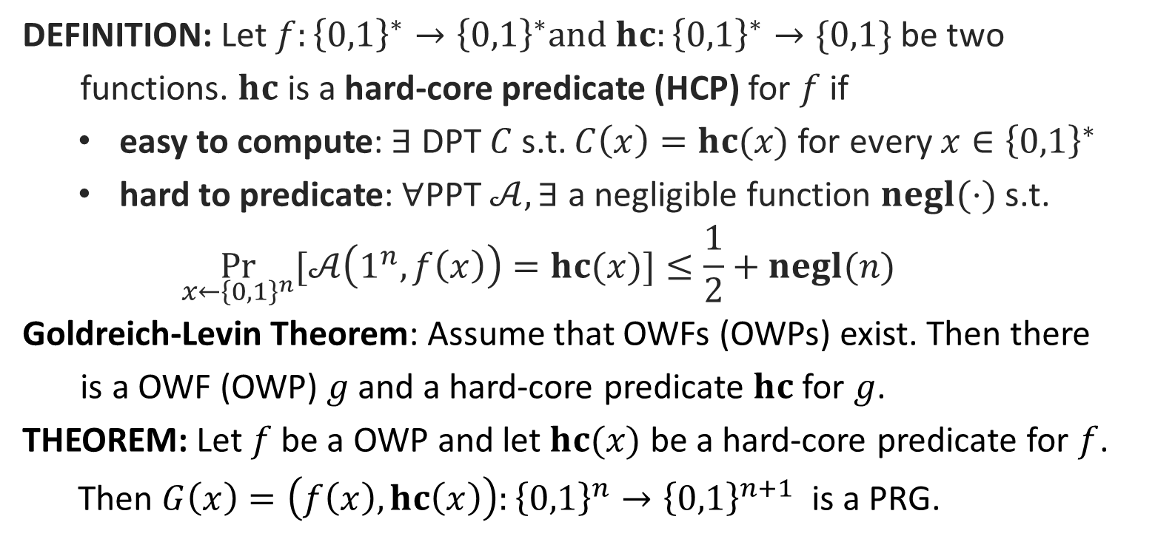
Hard-Core Predicate
DEFINITION: Let $f:{\left\{0,1\right\}}^{∗}→{\left\{0,1\right\}}^{∗}and hc:{\left\{0,1\right\}}^{∗}→\{0,1\}$ be two
functions. $hc$ is a hard-core predicate (HCP) for $f$ if
easy to compute: $∃$ DPT $C$ s.t. $C\left(x\right)=hc(x)$ for every $x∈{\left\{0,1\right\}}^{∗}$
hard to predicate: $∀$PPT $𝒜, ∃$ a negligible function $negl(⋅)$ s.t.
$$\underset{x←{\left\{0,1\right\}}^{n}}{Pr}{[𝒜\left(1^{n}, f\left(x\right)\right)=hc(x)]}≤\frac{1}{2}+negl(n)$$
Goldreich-Levin Theorem: Assume that OWFs (OWPs) exist. Then there
is a OWF (OWP) $g$ and a hard-core predicate $hc$ for $g$.
THEOREM: Let $f$ be a OWP and let $hc(x)$ be a hard-core predicate for $f$.
Then $G\left(x\right)=\left(f\left(x\right),hc\left(x\right)\right):{\left\{0,1\right\}}^{n}→{\left\{0,1\right\}}^{n+1}$ is a PRG.

Slide 9



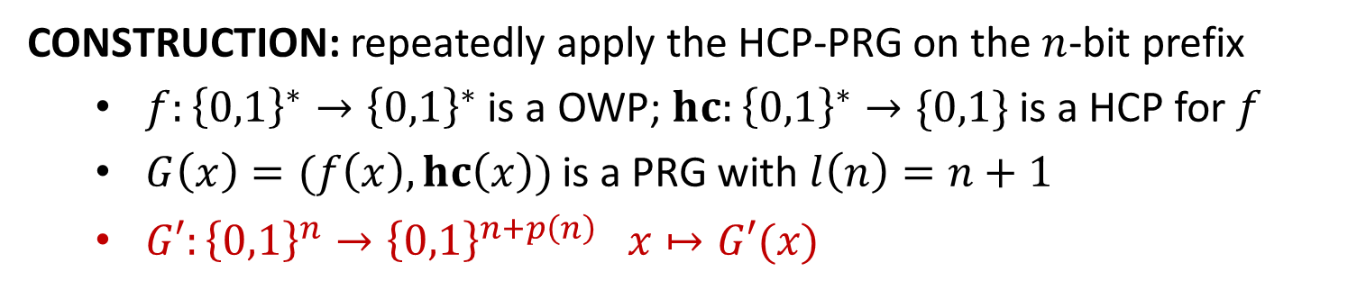
















PRG with Arbitrary Expansion
CONSTRUCTION: repeatedly apply the HCP-PRG on the $n$-bit prefix
$f:{\left\{0,1\right\}}^{∗}→{\left\{0,1\right\}}^{∗}$ is a OWP; $hc:{\left\{0,1\right\}}^{∗}→\{0,1\}$ is a HCP for $f$
$G\left(x\right)=(f\left(x\right),hc\left(x\right))$ is a PRG with $l\left(n\right)=n+1$
$G′:{\left\{0,1\right\}}^{n}→{\left\{0,1\right\}}^{n+p\left(n\right)} x↦G′(x)$
$$G′\left\{\begin{aligned} \\ \\ \\ \\ \\ \\ \\ \\ \\ \end{aligned}\right.$$
$$x$$
$$hc(x)$$
$$x$$
$$G↓$$
$$f(x)$$
$$hc(f(x))$$
$$hc(x)$$
$$G↓$$
$$f(f(x))$$
$$⋮$$
$$⋮$$
$$hc(f^{(p\left(n\right)−1)}(x))$$
$$f^{(p\left(n\right))}(x)$$
$$⋯⋯$$
$$G′(x)$$
$n$ bits
$p(n)$ bits
THEOREM: The function $G′$ is a PRG with expansion factor $n+p(n)$.

Slide 10


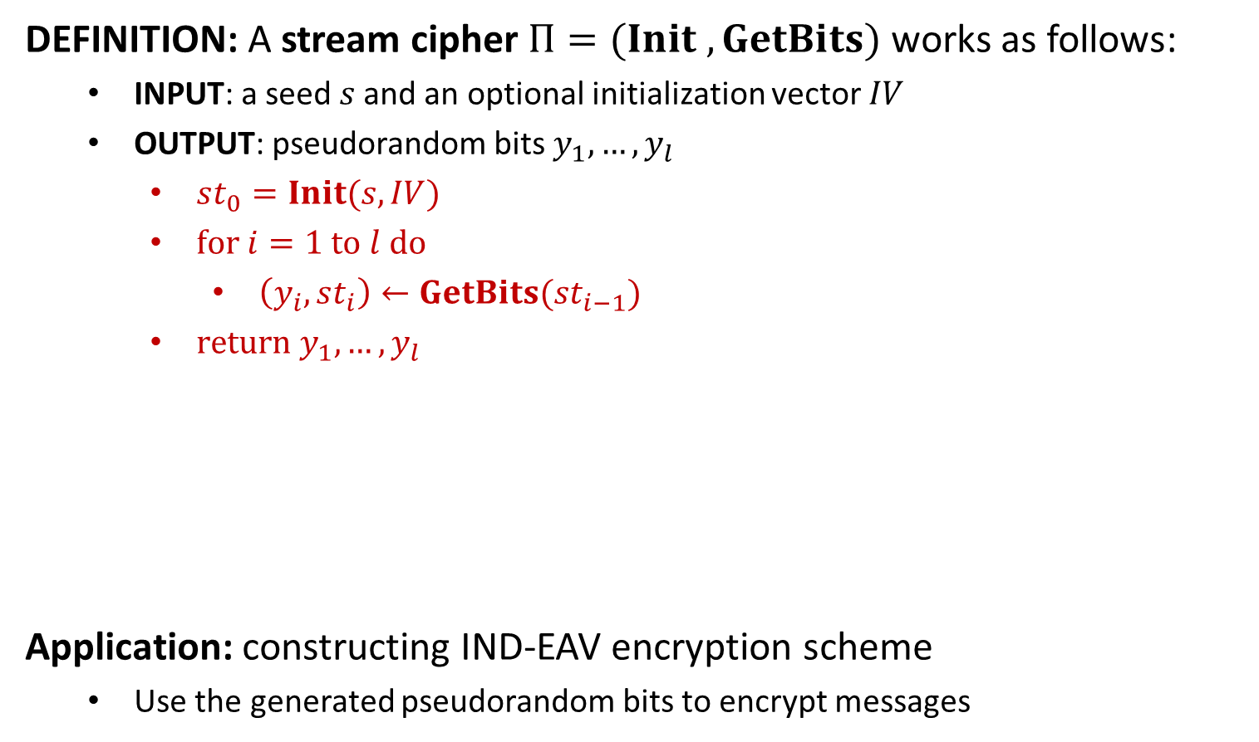








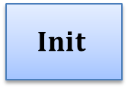


Stream Cipher
DEFINITION: A stream cipher $Π=(Init , GetBits)$ works as follows:
INPUT: a seed$s$and an optional initialization vector $IV$
OUTPUT: pseudorandom bits $y_{1},…,y_{l}$
$st_{0}=Init(s,IV)$
$for i=1 to l do$
$\left(y_{i}, st_{i}\right)←GetBits(st_{i−1})$
$return y_{1},…,y_{l}$
Application: constructing IND-EAV encryption scheme
Use the generated pseudorandom bits to encrypt messages
$$s$$
$$Init$$
$$st_{0}$$
$$GetBits$$
$$st_{1}$$
$$GetBits$$
$$st_{2}$$
$$GetBits$$
$$st_{3}$$
$$IV$$
$$⋯$$
$$y_{1}$$
$$y_{2}$$
$$y_{3}$$
$$⋯$$

Slide 12


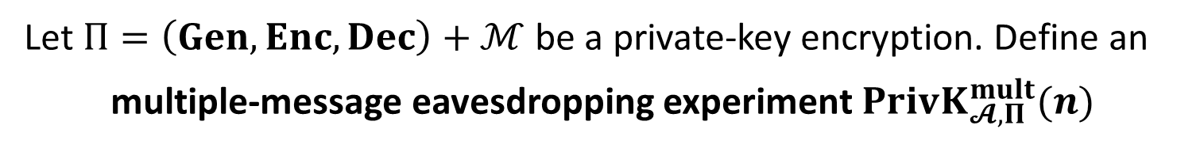



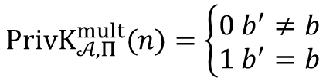


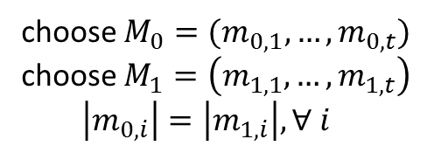

IND-m-EAV
Let $Π=\left(Gen, Enc, Dec\right)+ℳ$ be a private-key encryption. Define an
multiple-message eavesdropping experiment $PrivK_{𝓐, Π}^{mult}(n)$
choose $M_{0}=(m_{0,1},…,m_{0,t})$
choose $M_{1}=\left(m_{1,1},…,m_{1,t}\right)$
$\left|m_{0,i}\right|=\left|m_{1,i}\right|, ∀ i$
$$M_{0},M_{1}$$
$$k←Gen\left(1^{n}\right)$$
$$Challenger$$
$$b←\{0,1\}$$
$$Adversary 𝒜$$
$$c_{i}←Enc(k,m_{b,i})$$
$$C=(c_{1},…,c_{t})$$
$$b′$$
$$PrivK_{𝒜, Π}^{mult}(n)=\left\{\begin{aligned}0 b^{′}≠b \\ 1 b^{′}=b\end{aligned}\right.$$
$t$: can be any polynomial function in $n;$ chosen by the adversary

Slide 13
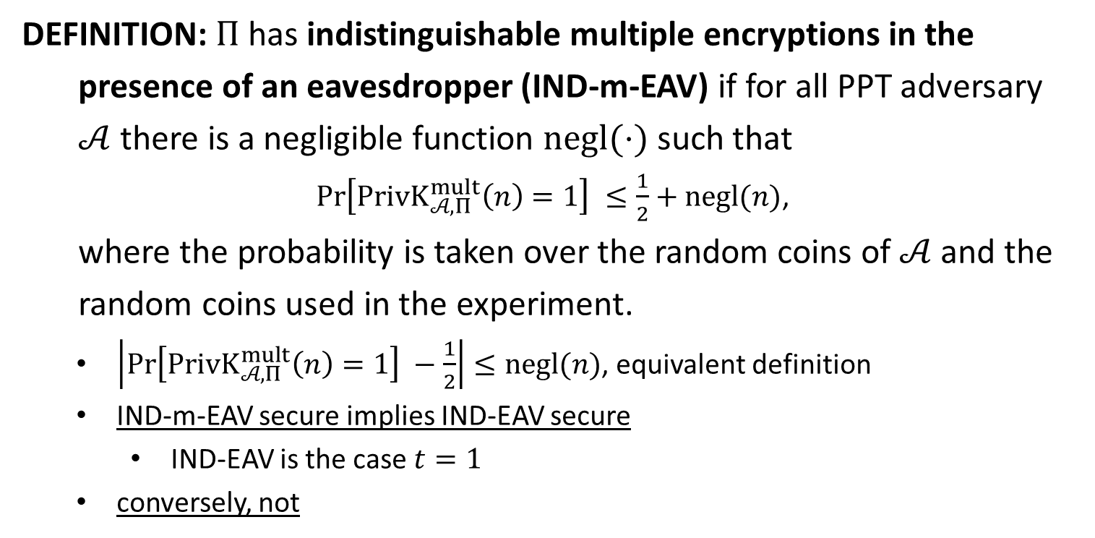
IND-m-EAV
DEFINITION: $Π$has indistinguishable multiple encryptions in the
presence of an eavesdropper (IND-m-EAV) if for all PPT adversary
$𝒜$ there is a negligible function $negl(⋅)$ such that
$\operatorname{Pr}\left[PrivK_{𝒜, Π}^{mult}\left(n\right)=1\right] ≤\frac{1}{2}+negl(n)$,
where the probability is taken over the random coins of $𝒜$ and the
random coins used in the experiment.
$\left|\operatorname{Pr}\left[PrivK_{𝒜, Π}^{mult}\left(n\right)=1\right] −\frac{1}{2}\right|≤negl(n)$, equivalent definition
IND-m-EAV secure implies IND-EAV secure
IND-EAV is the case $t=1$
conversely, not

Slide 14
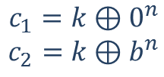

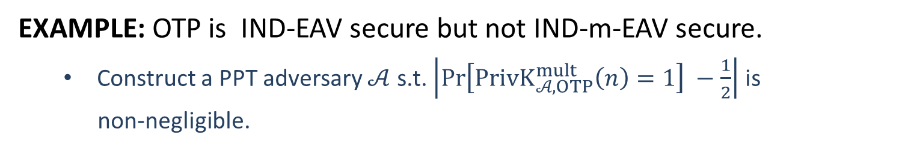






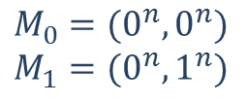

IND-m-EAV
EXAMPLE: OTP is IND-EAV secure but not IND-m-EAV secure.
Construct a PPT adversary $𝒜$ s.t. $\left|\operatorname{Pr}\left[PrivK_{𝒜, OTP}^{mult}\left(n\right)=1\right] −\frac{1}{2}\right|$ is
non-negligible.
$$M_{0}=(0^{n}, 0^{n})$$
$$M_{1}=(0^{n},1^{n})$$
$$M_{0},M_{1}$$
$$k←{\left\{0,1\right\}}^{n}$$
$$b←\{0,1\}$$
$$Challenger$$
$$Adversary 𝒜$$
$$c_{1}=k⊕0^{n}$$
$$c_{2}=k⊕b^{n}$$
$$C=(c_{1},c_{2})$$
$$b′$$
$$b^{′}=0 iff c_{1}=c_{2}$$

Slide 15
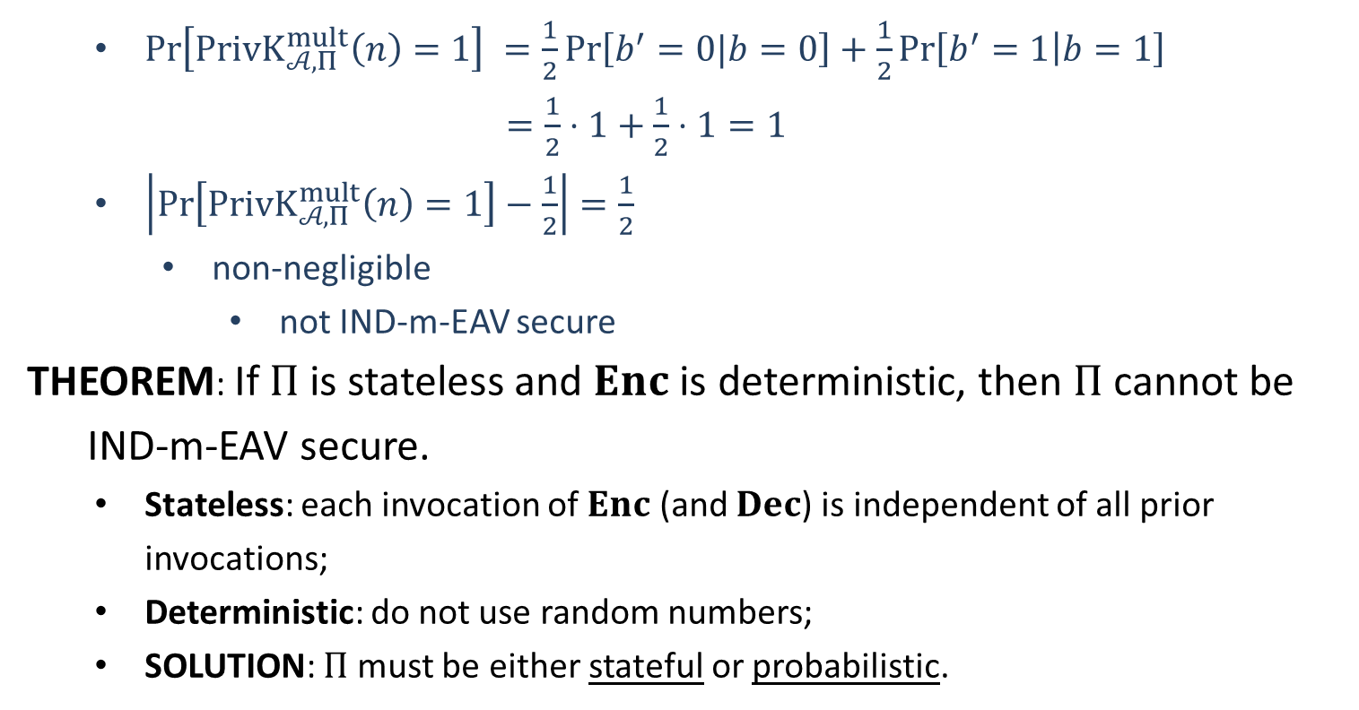
IND-m-EAV
$\operatorname{Pr}\left[PrivK_{𝒜, Π}^{mult}\left(n\right)=1\right] =\frac{1}{2}\operatorname{Pr}\left[b^{′}=0|b=0\right]+\frac{1}{2}\operatorname{Pr}\left[b^{′}=1 | b=1\right]$
$=\frac{1}{2}⋅1+\frac{1}{2}⋅1=1$
$\left|\operatorname{Pr}\left[PrivK_{𝒜, Π}^{mult}\left(n\right)=1\right]−\frac{1}{2}\right|=\frac{1}{2}$
non-negligible
not IND-m-EAV secure
THEOREM: If $Π$ is stateless and $Enc$ is deterministic, then $Π$ cannot be
IND-m-EAV secure.
Stateless: each invocation of $Enc$ (and $Dec$) is independent of all prior invocations;
Deterministic: do not use random numbers;
SOLUTION: $Π$ must be either stateful or probabilistic.

